Slide 1

Model Site Catalogue Template

Slide 2
Introduction
The aim of Model Site Catalogue is to standardize and document the possible Tx Site equipment configurations to be implemented. By doing this, the design options are constrained which simplifies the overall process.
Model Site Granularity Definition
In order to create the catalogue, the granularity to be used must be defined. This granularity will dictate the different variations to be included on the catalogue. The possible alternatives to be used to establish the granularity are:
Transport Technologies; Tx Equipment Vendor; RAN Equipment; Vendor Solution; Transport Vendor:
Model Site Catalogue Generation
Based on selected granularity, an identification of all possible scenarios is perform. Then, a high-level description of each scenario solution must be described. Following a list of characteristics that must be identified for each scenario:
Network elements characteristics (quantities, equipment model, description)
Interconnection schemes (Interconnection matrix or diagram, interface description, cable type)

Slide 3
Model Sites – Tx Technology
Model Site 1 – Scenario Description
Topology Image
(Interconnection scheme)
Material Description
Element | Quantity | Model | Description
NE 1
NE 2
NE 3

Slide 4
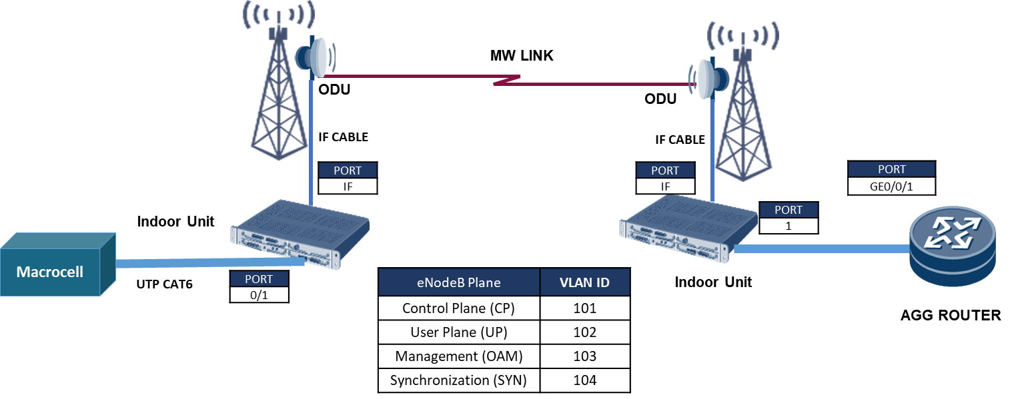
Model Sites – Tx Technology (Example)
Model Site 1 – Microwave | Macro Cell | 5km < Distance < 15km
Material Description
Element | Quantity | Model | Description
NE 1 | 2 | MW Vendor A - IDU Unit | IDU Unit
NE 2 | 2 | MW Vendor A - ODU Unit | ODU Unit @11GHz
NE 3 | 2 | MW Antenna | Antenna 0.6m
NE 4 | 4 | SFP+ Module | Enhanced Small Form-factor Pluggable Transceiver, 1GE, Electrical, 1000BASE T
NE 5 | 4 | Patch Cord | Electrical Patch Cable, 10m

